Slide 1
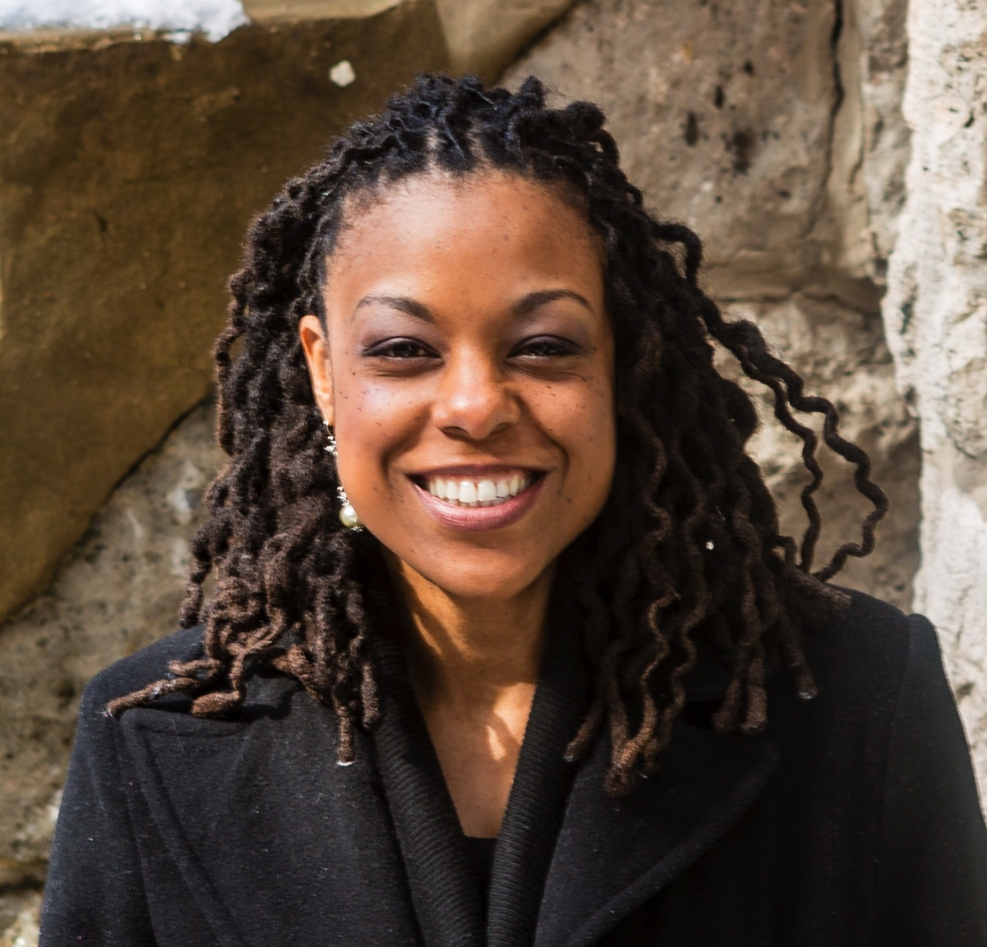
Desensitization to Community Violence in Adolescents: Implications for Trauma-Informed Interventions
Noni Gaylord-Harden
Loyola University - Chicago
Wednesday, March 8 @ Noon
117 Haggar Hall
University of Notre Dame
Professor Gaylord-Harden will discuss current models of reactivity to community violence exposure in youth of color from economically-disadvantaged communities, review empirical research examining reactivity to community violence, and outline how current research can inform intervention and treatment efforts with violence-exposed youth.
http://pacctlab.weebly.com/

